Slide 1
DOCTORAPPOINTMENTAPP
PIP104 PROFESSIONAL PRACTICE-II
VIVA-VOCE
Batch Number:CSEG-143
Roll Number | Student Name
AISHWARYA ANJALI SHRADHA | 20201CSE0717 20201CSE0720 20201CSE0725
Under the Supervision of,
Dr. Manish Goswami
Associate Professor
School of Computer Science Engineering
Presidency University

Slide 2
Introduction
The DoctorAppointmentApp project involves patient registration, data entry into the system, and utilization by labs and pharmacies. The app allows each patient to have a unique ID, and it automatically saves information about each patient and staff member. You can log in to the DoctorAppointmentApp with your username and password.
This application has been designed and built to offer hospitals tangible and foreseeable benefits. It is robust, adaptable, and simple to use. It is intended to address a broad variety of hospital administration and management procedures in multispeciality institutions. It is a comprehensive, integrated hospital management system that seamlessly transfers pertinent data throughout the hospital to enable efficient decision-making for patient care, administrative tasks, and vital financial accounting.

Slide 3
Literature Review
Digvijay H [1] the administration of emergency clinic to create programming which is more clears by the client and play out the basic and quick. It incorporates the assortment of patient subtleties and specialist subtleties. The framework stores all information and recovers when required .The emergency clinic the board framework can be entered by utilizing client name and secret key which gotten to by a chairman the information will be secured securely for any utilization .The medical clinic the board framework is important to store the patient subtleties specialist subtleties and staffs and so forth Subsequently by these venture the work become simple and spares part.

Slide 4
Literature Review
Shafaq Malik [2] If we need to visit a specialist for exam we need to stand by until the specialist accessible and get arrangement as the portable innovation is creating it is simple to get arrangement from specialist. The portable application acknowledges arrangements by sparing the records of the arrangements which is connected with schedule. The client gets notices dependent on the present indicated time before the arrangement. This application is simple and neighborly with client reason. Here the administrator will deal with the specialist and patient subtleties.

Slide 5
Research Gaps Identified
Interoperability and Integration
User Experience and Interface Design
Data Security and Privacy
Telehealth Integration
Artificial Intelligence (AI) and Analytics
Mobile Health (mHealth) Applications
Scalability and Adaptability
Cost-Benefit Analysis

Slide 6
Proposed Methodology
Any hospital can use the DoctorAppointmentApp to replace their current manual, paper-based system.
The following data will be under the control of the new system:
1. Patient data
2. Availability of the doctor
3. The system of appointments
4. Online access to the patient's medication and information
5. The patient's history and appointment can be scheduled online
The objective of these services is to minimize the time and resources now needed for similar jobs by offering them in an efficient and cost-effective manner.

Slide 7
Objectives
The following is a summary of a hospital management system's goals:
Efficient Patient Care: By giving medical personnel immediate access to patient records, treatment histories, and diagnostic data, you may enhance the standard and effectiveness of patient care.
Streamlined Workflow: To cut down on errors and save time, streamline hospital administrative duties and processes such appointment scheduling, patient admittance, and invoicing.
Accurate Patient Records: To enable improved patient monitoring, diagnosis, and treatment, keep accurate and current electronic health records (EHR).
Appointment management: Make it simple for patients to make appointments, cutting down on wait times and guaranteeing that medical professionals' time is used effectively.

Slide 8
System Design
Conditions Analysis: Compile and evaluate stakeholder requirements, such as those from hospital employees, managers, and patients. Determine the essential features, including electronic health records (EHR), billing, appointment scheduling, patient registration, inventory management, etc.
System Architecture: Based on the needs and scalability of the system, select an appropriate architecture (such as client-server or microservices).Specify modules for various functions, such as inventory management, staff management, and patient management.
User Interface Design: Develop an interface that is simple to use and intuitive for a variety of user roles, including administrators, patients, doctors, and nurses. Prior to deployment, visualise the user interface via wireframes and mockups.

Slide 9
System Implementation
Frontend Development: Apply the design specifications to the user interface's implementation. Employ suitable technologies, like XML.
Backend Development: Construct the backend logic necessary to manage various functionalities. Select Java as your programming language.
Database Implementation: Build and configure the database in accordance with the schema that has been created. For data manipulation, use the CRUD (Create, Read, Update, Delete) methods.
System deployment: Set up the system on a scalable, secure infrastructure. Once the system is deployed, keep an eye on its performance.

Slide 10
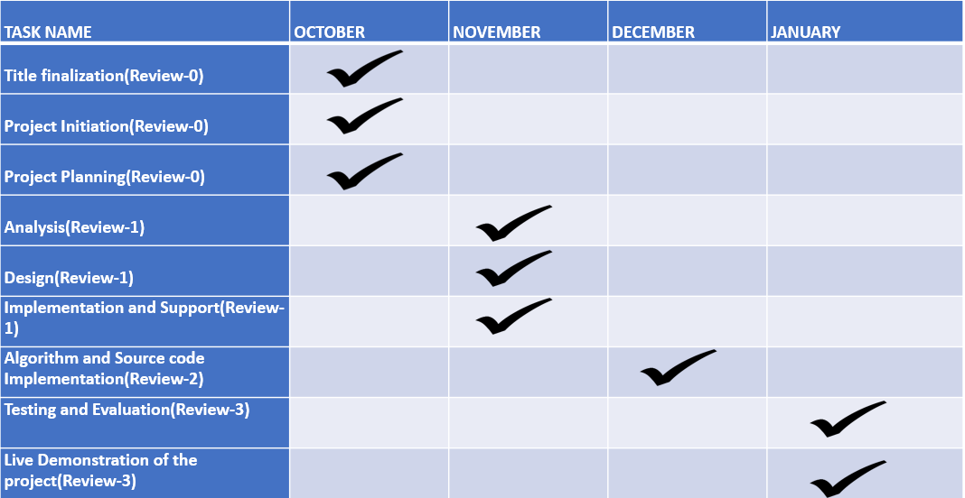
Timeline of Project

Slide 11
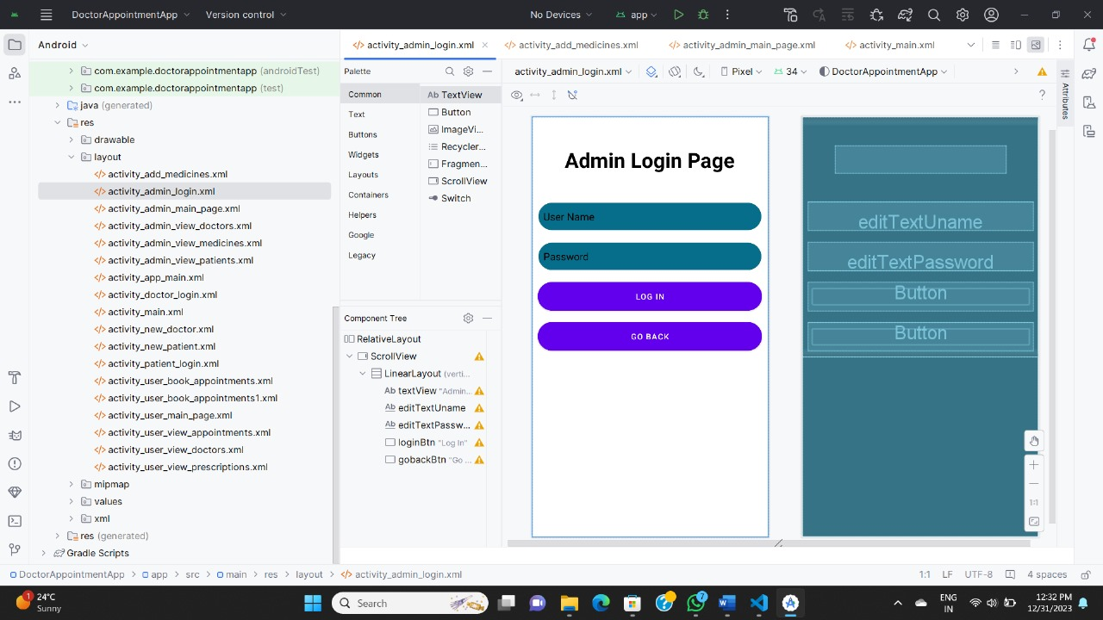
Outcomes / Results Obtained

Slide 12
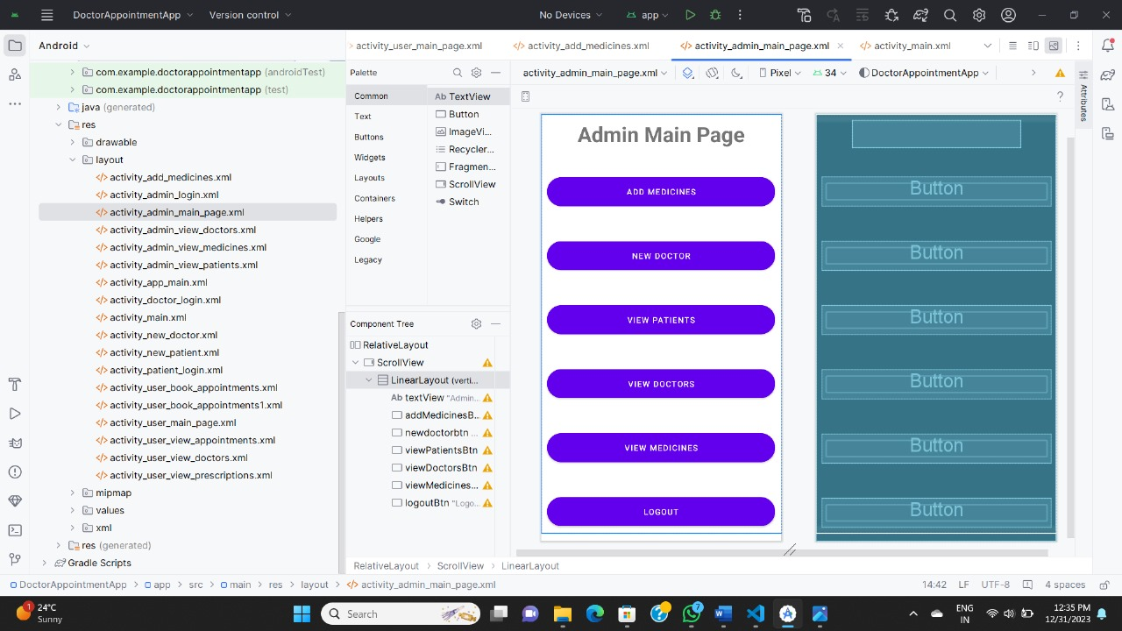
Outcomes / Results Obtained

Slide 13
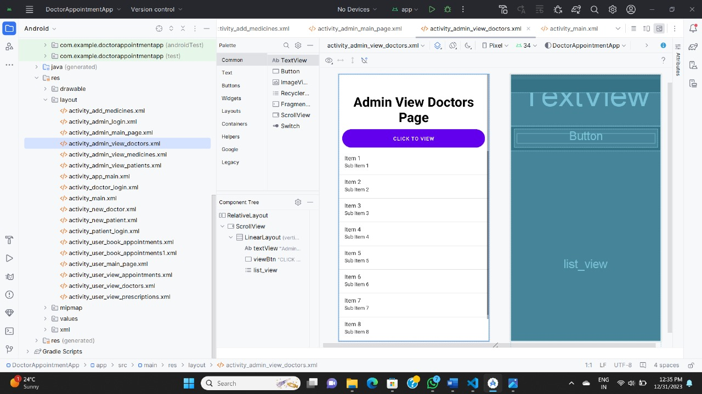
Outcomes / Results Obtained

Slide 14
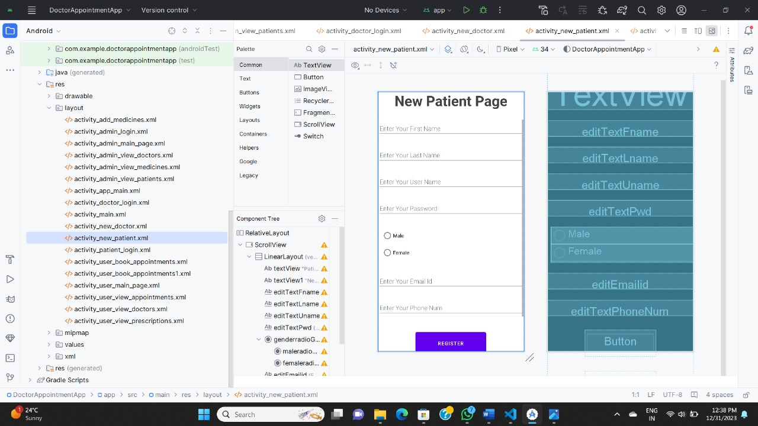
Outcomes / Results Obtained

Slide 15
Conclusion
To sum up, the adoption of an DoctorAppointmentApp is a critical first step toward transforming the management of healthcare. The system's objectives, which range from patient registration to interfacing with external systems, are carefully considered in order to improve overall efficiency, lower mistake rates, and raise the standard of patient care. The adoption of electronic health records (EHR) facilitates the creation of a centralized, seamless repository, which enhances healthcare providers' ability to collaborate and improves the accuracy of medical data.
Simplified billing procedures, integration of telemedicine, and appointment scheduling all help to provide patients and employees with the best possible healthcare experience. By placing a strong focus on security and data protection, the system complies with legal requirements like HIPAA and protects patient privacy.

Slide 16
References
[1] Digvijay H, Gadhari, Yadnyesh, P Kadam, Prof. Parineeta Suman(2016) "Hospital Management System", IJREAM, 01:11.
[2] Shafaq Malik, Nargis Bibi, Sehrish Khan, Razia Sultana, Sadaf Abdul Rauf (2016) "Mr.Doc:A Doctor Appointment Application System". International Journal of Computer Science an Information Security, 14(12):452-460.
[3] Irin Sherly S, Mahalakshmi A, Menaka D, Sujatha R (2016) "Online Appointment Reservation and Scheduling for Healthcare- A Detailed Study", International Journal of Innovative Research in Computer and Communication Engineering. 4: 2.
[4] Maryam Tufail (2018) "Online Polyclinic Appointment and Database Management System”, Master's thesis 43 pages appendices 1 page.
[5] Godphrey G Kyambille, Khamisi Kalegele(2015) "Enhancing Patient Appointments Scheduling that Uses Mobile Technology", IJCSIS, Vol.13:11.

Slide 17

Thank You

